Slide 1


Digital Content Design
Using Canva
Designing Visually Stunning & Professional Content
Presented by:
Ms. Sameera Muhammad Iqbal

Slide 2
Our objectives
Understand what Canva is and its value in the professional world.
Learn to confidently navigate the Canva workspace and editor.
Create professional, high-quality assets (resumes, pitch decks, posters).
Leverage Canva’s AI tools to work smarter and faster.

Slide 3

What is ?
Canva is an online design and visual communication platform that lets anyone create professional graphics, presentations, videos, and documents.
For university students and future professionals, it is a powerful tool to democratize visual communication. It empowers you to transform everyday projects, research summaries, and job applications into compelling visual stories, all without requiring formal graphic design training.

Slide 4
Why choose ?
Canva is incredibly easy to use with its simple drag-and-drop tools, so we don't need any prior design experience. It saves our time by offering ready-made templates for presentations, posters, and resumes. It also works directly in our web browser, making it easy to share files and work together with our classmates on group projects in real-time.

Slide 5

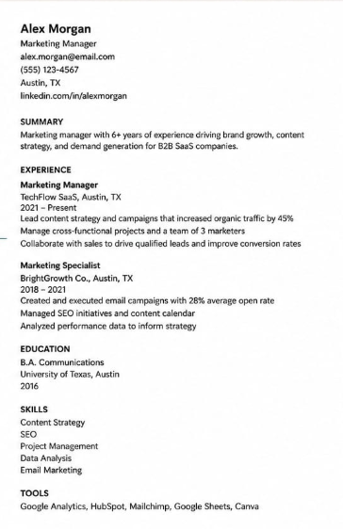
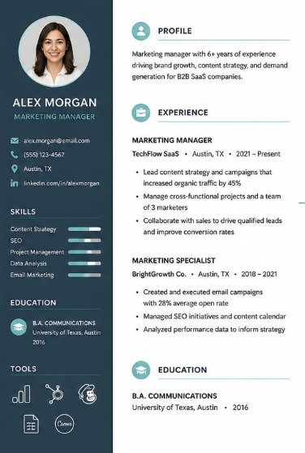
Traditional Approach
The Canva Edge
Standard, text-heavy documents that blend in. Relying on default templates often results in a lack of visual attraction, making it difficult to capture your audience's attention.
Visually striking, modern designs that communicate professionalism. Strategic use of color, typography, and layout instantly elevates your message.

Slide 6
Live Demonstration
Building Your Resume

Slide 7
Demo Overview
What We Will Cover
Touring the workspace and selecting a professional resume template
Customizing text, fonts, and colors to build your personal brand
Uploading a professional headshot and formatting it using image frames
Exporting the finished design as a high-quality PDF

Slide 8

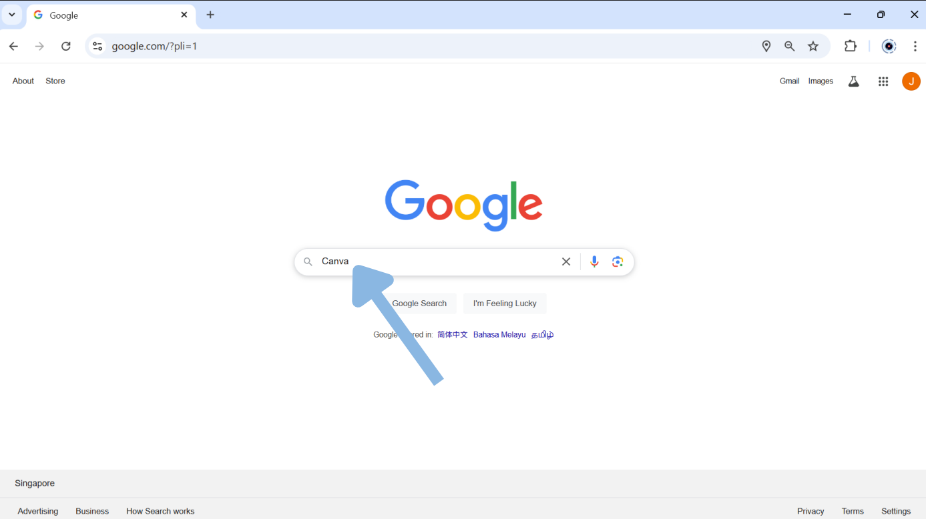
Getting Started:
Search for "Canva" on Google.

Slide 9
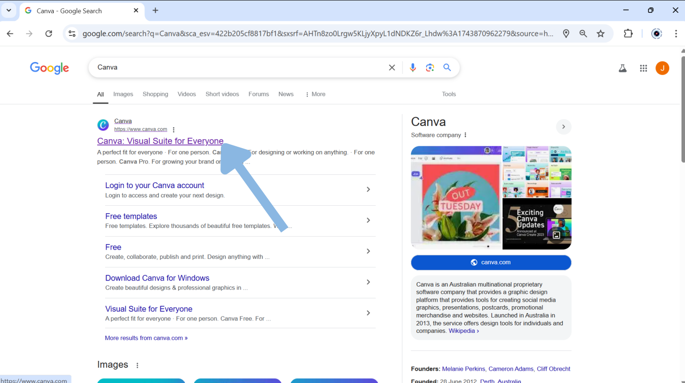
Getting Started:
Click on the official Canva website link in the search results.

Slide 10
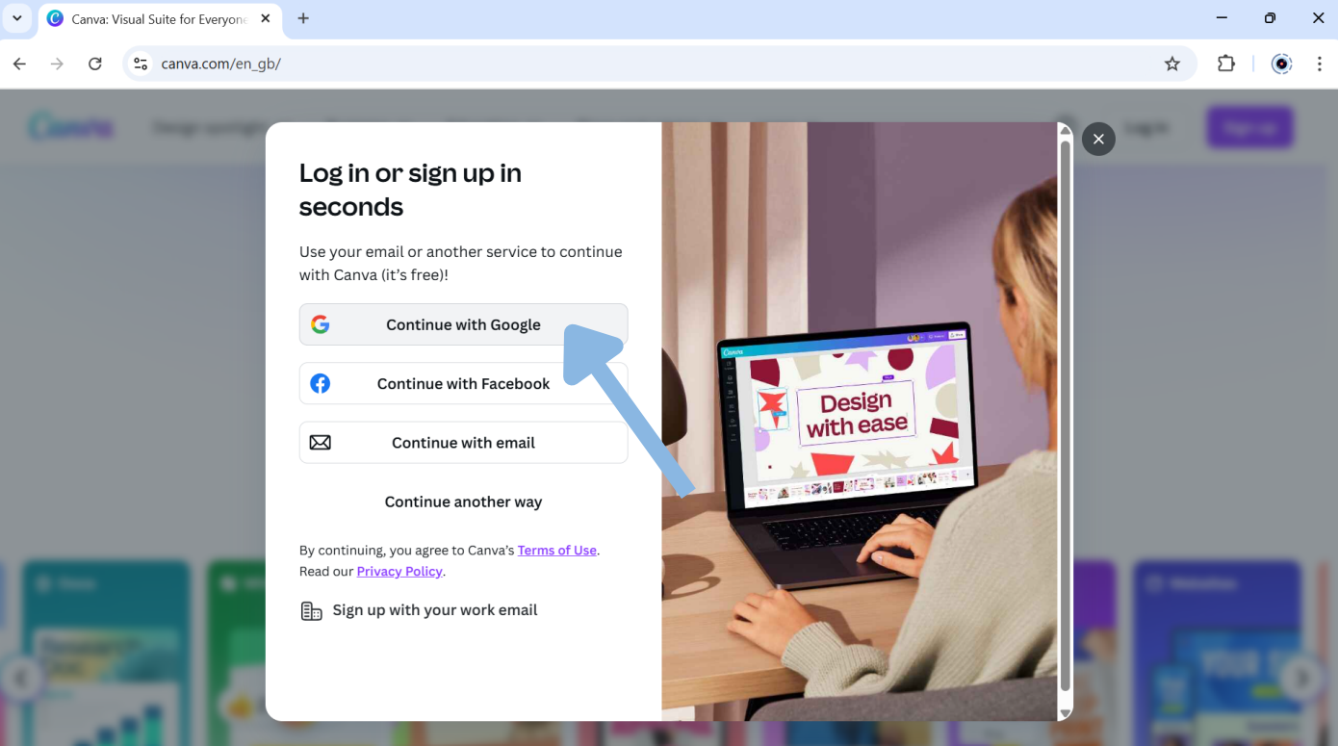
Getting Started:
Sign up for a free account or log in to access the platform.

Slide 11
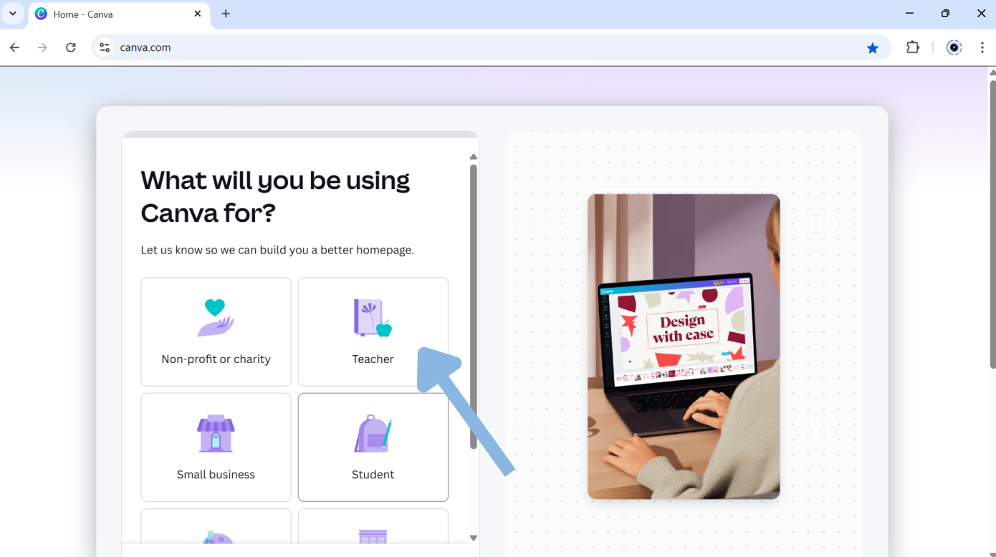
Getting Started:
Select what you will be using Canva for (Student for your case)

Slide 12
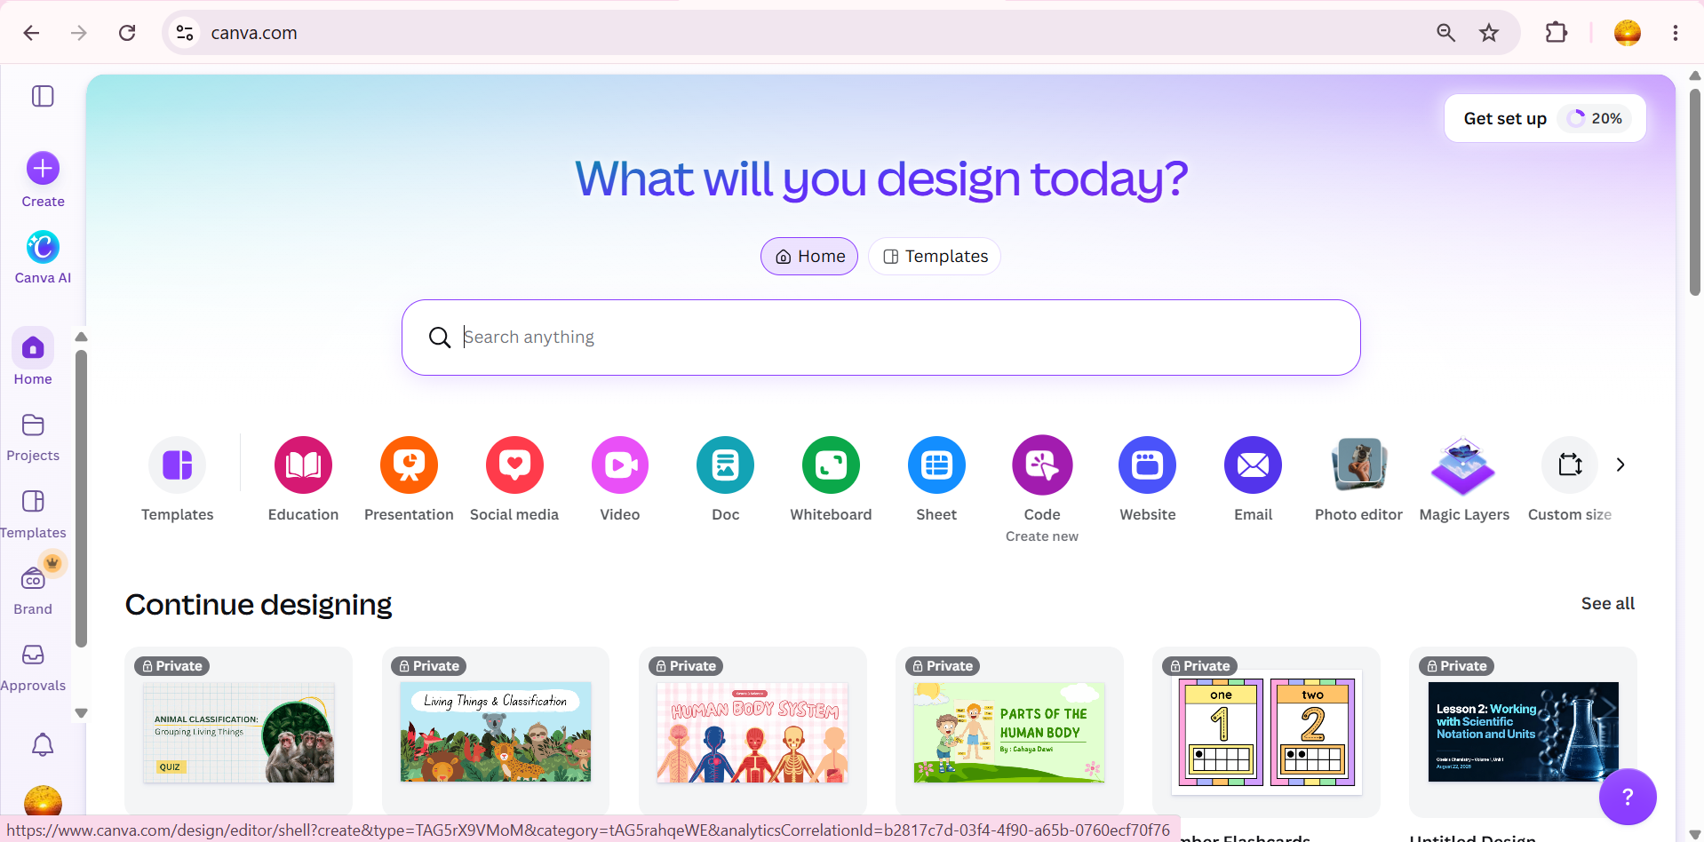
Exploring the Workspace:
The Left Sidebar is your primary menu, located on the far left side of the screen.

Slide 13
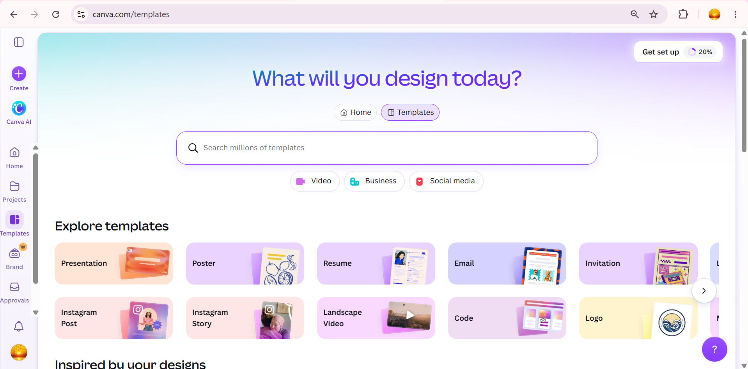
Exploring the Workspace:
Click the “Templates” to view all the design templates and choose “Resume”.

Slide 14
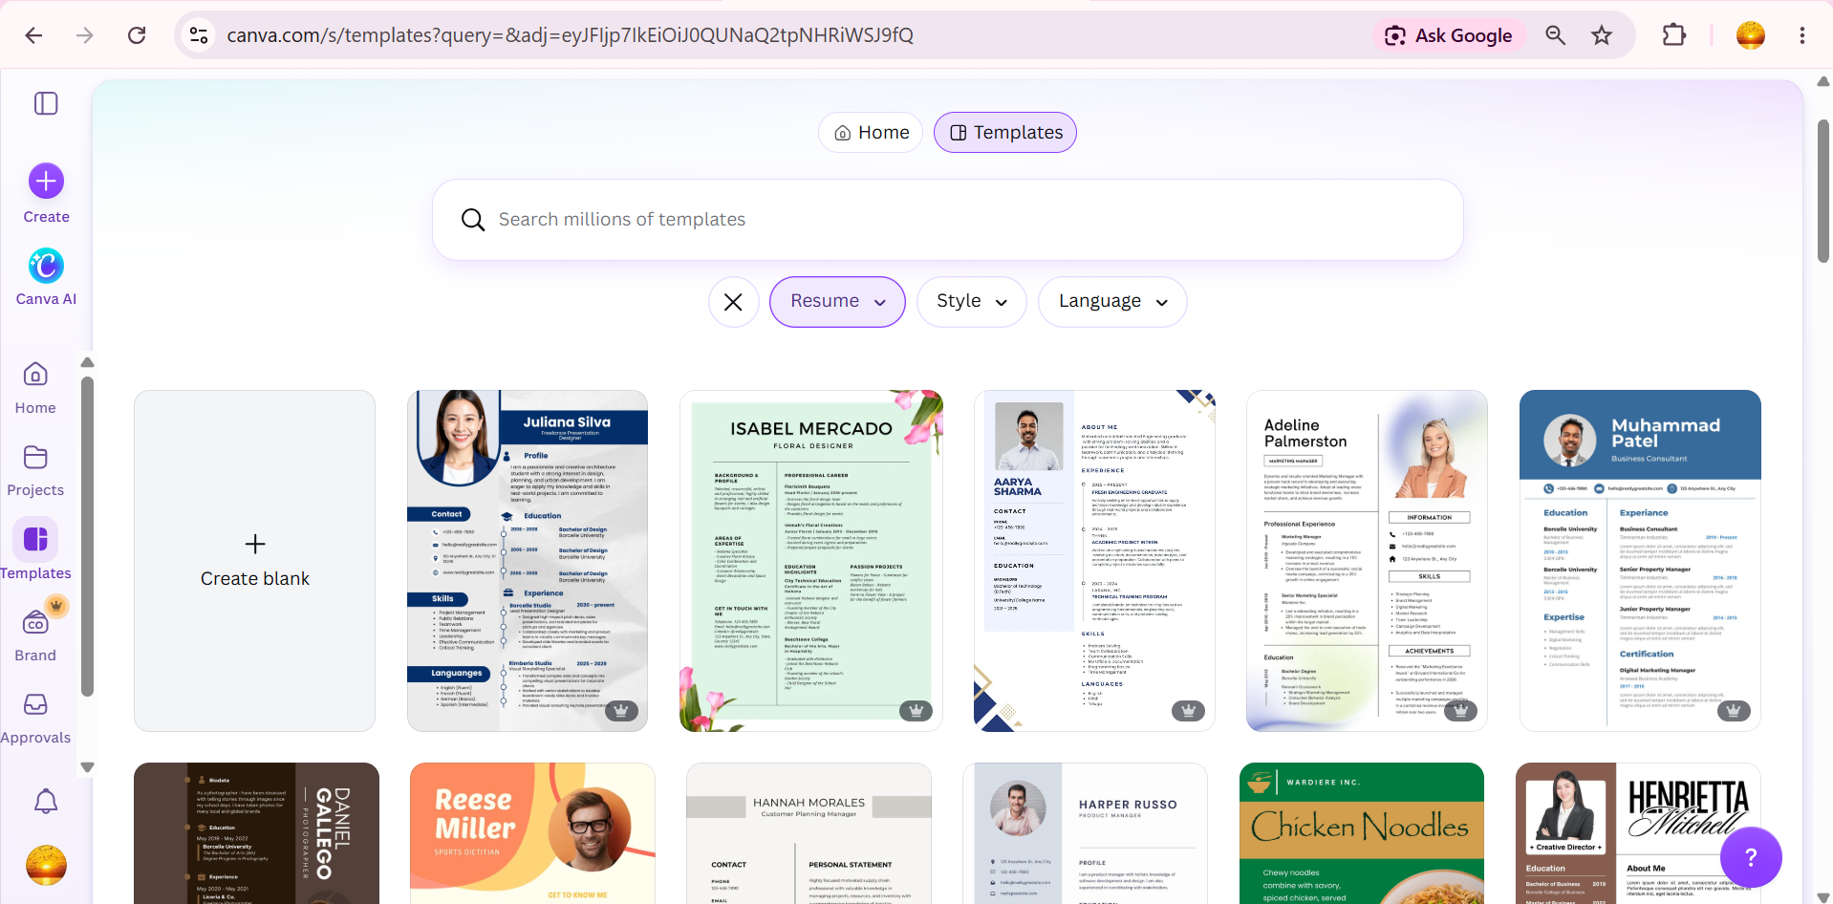
Exploring the Workspace:
Choose any template that suits you or if you want, you can create your own.

Slide 15
Lets do it!
You can join me if you want on your devices and follow along.

Slide 16
Share your work
Download your completed resume as a PDF document.
Scan the QR code below using your phone camera.
Upload your file to the digital board to share your design.

Slide 17



Picture Editing
I can edit my pictures using photoshop being professional.
Canva is Non-destructive, automated drag-and-drop without photo retouching and you can find Graphic layout, social media content and many templates.

Slide 18

Social Media Content
Ok you can’t win against Adobe express.
You are Right, but I provide Massive template ecosystem & end-to-end publishing.

Slide 19
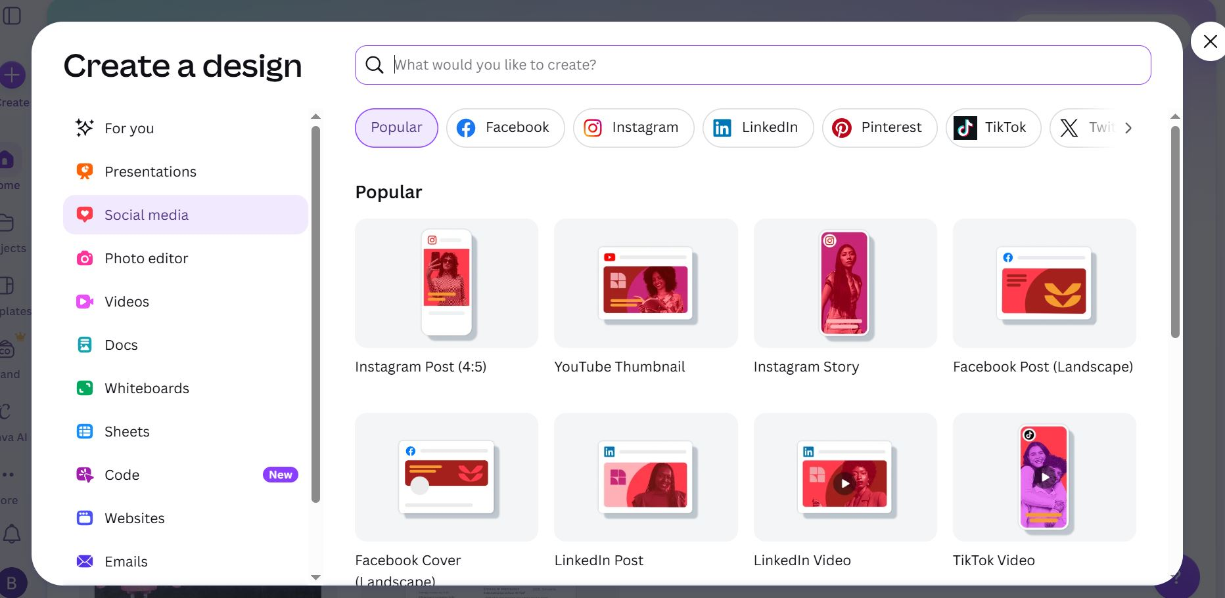

Slide 20
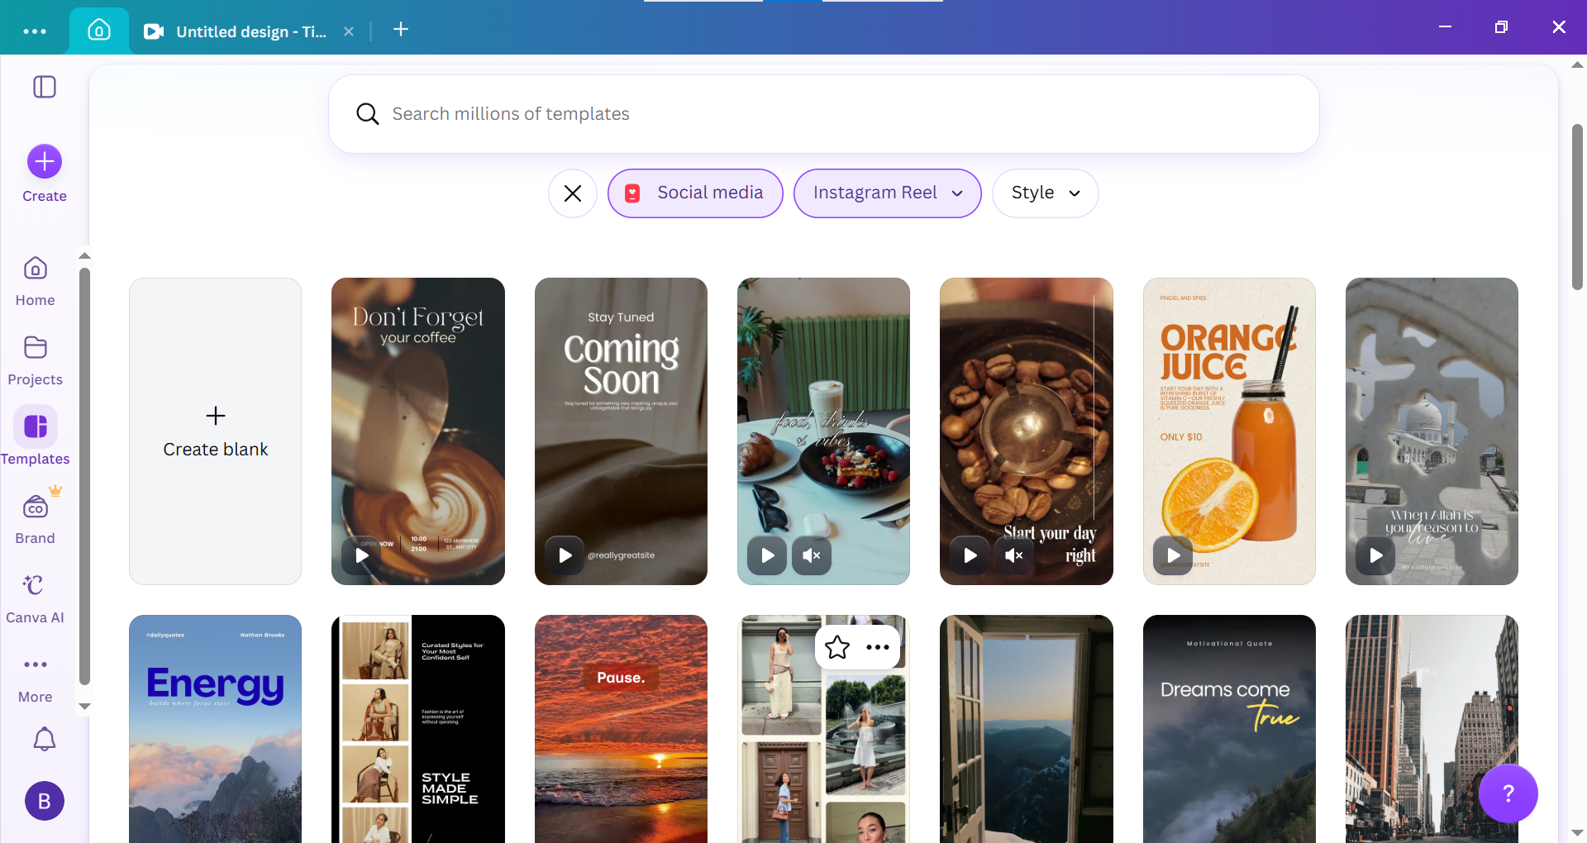

Slide 21

Generating Invoice
Through Canva I can customize many invoices just by Full drag-and-drop design freedom 😊
I made an invoice for my buyer using ZOHO invoice
Yahooo 😁

Slide 22
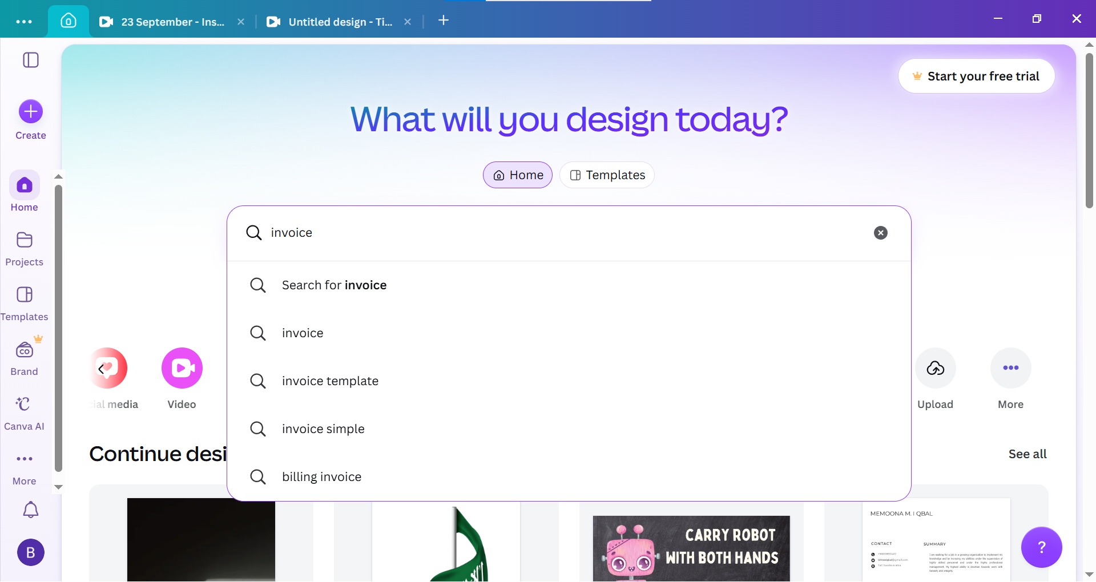

Slide 23
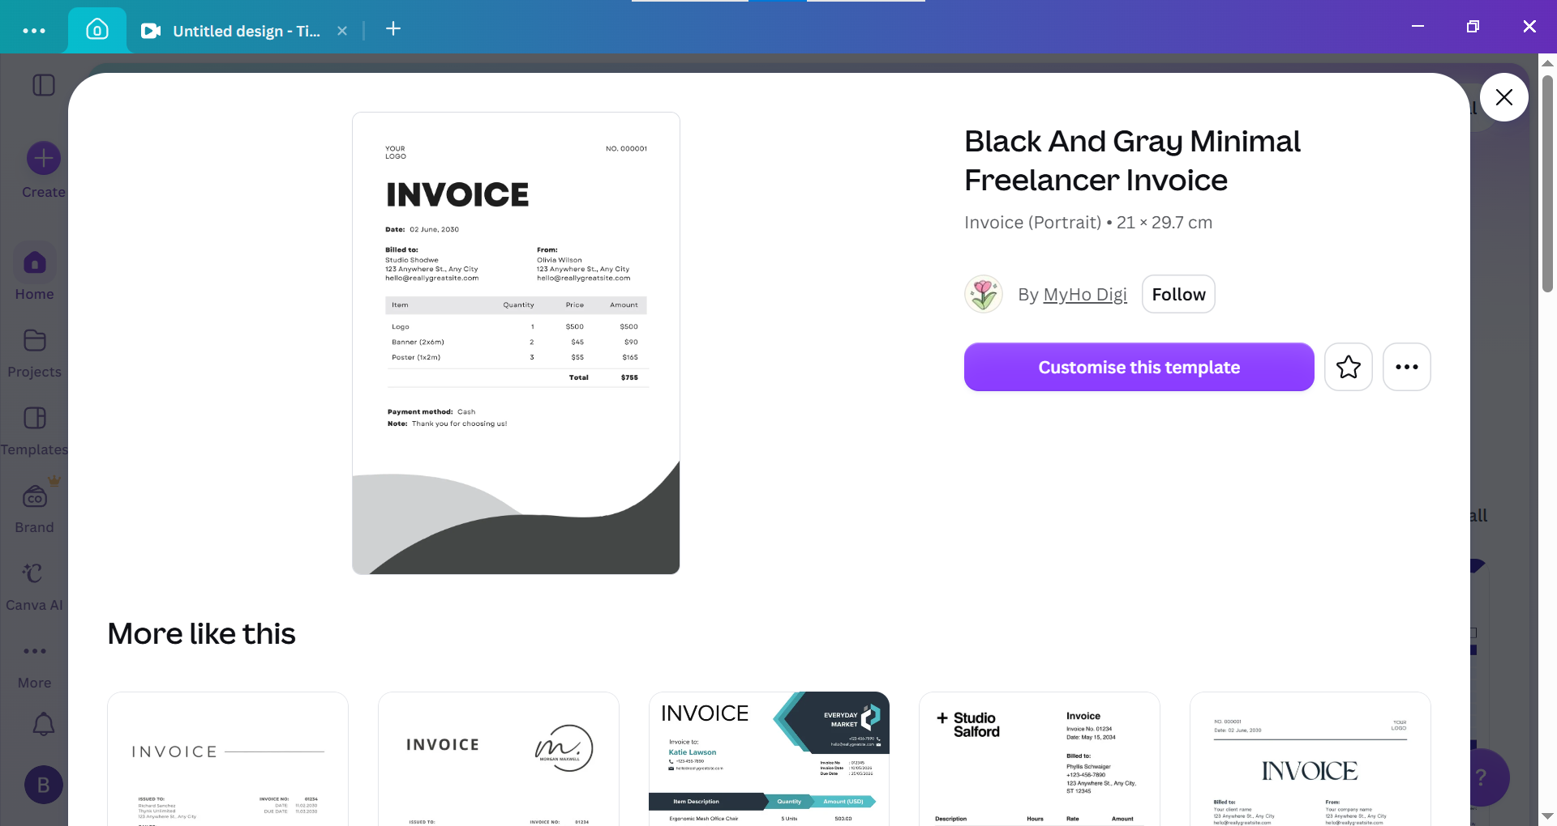

Slide 24
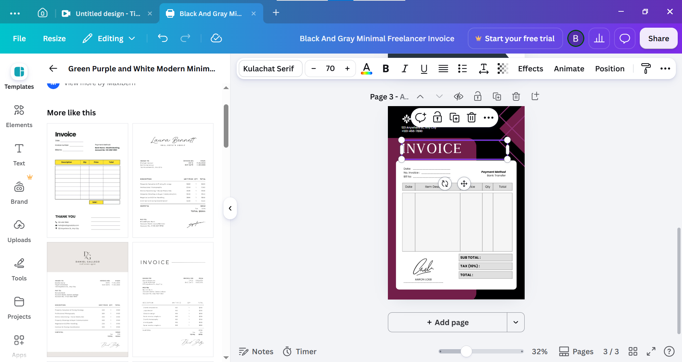

Slide 25

Creating Websites
Wix is functional, searchable, multi-page website. Full SEO toolsets (custom URLs, sitemaps, alt tags, schema markup)
Canva is built using custom HTML canvas rendering to allow fluid drag-and-drop mechanics in standard browsers.

Slide 26
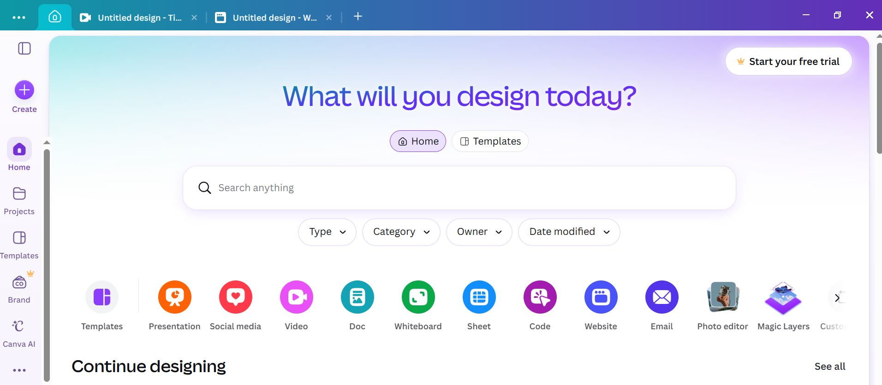

Slide 27
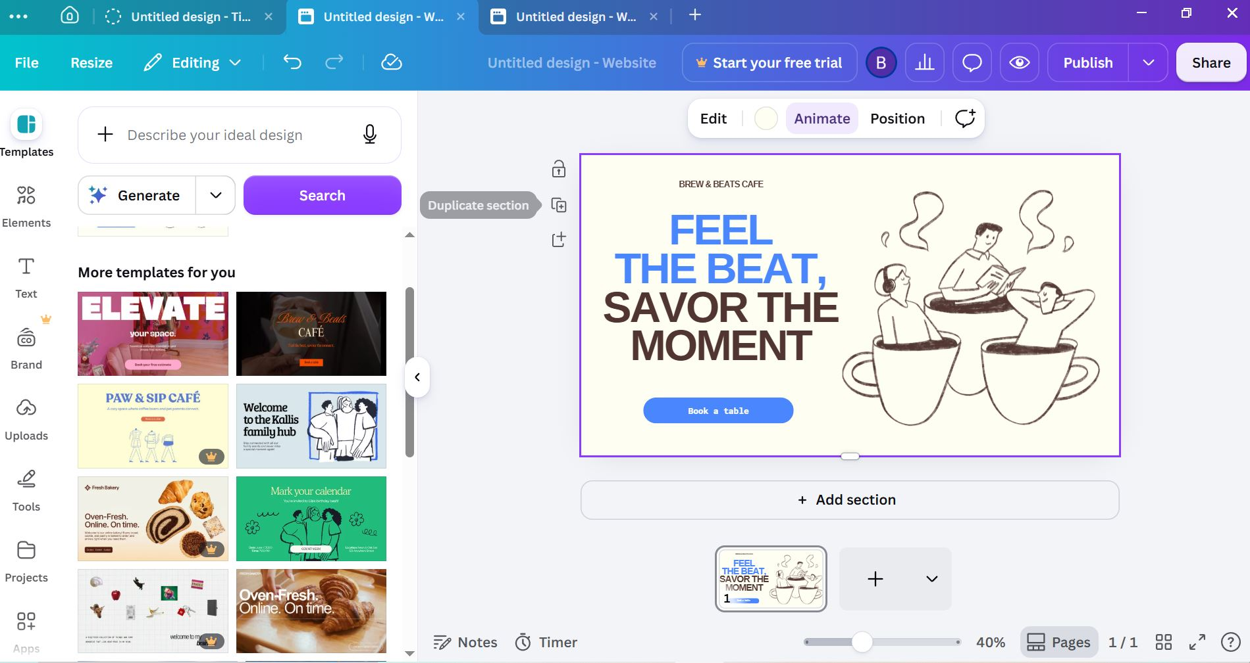

Slide 28

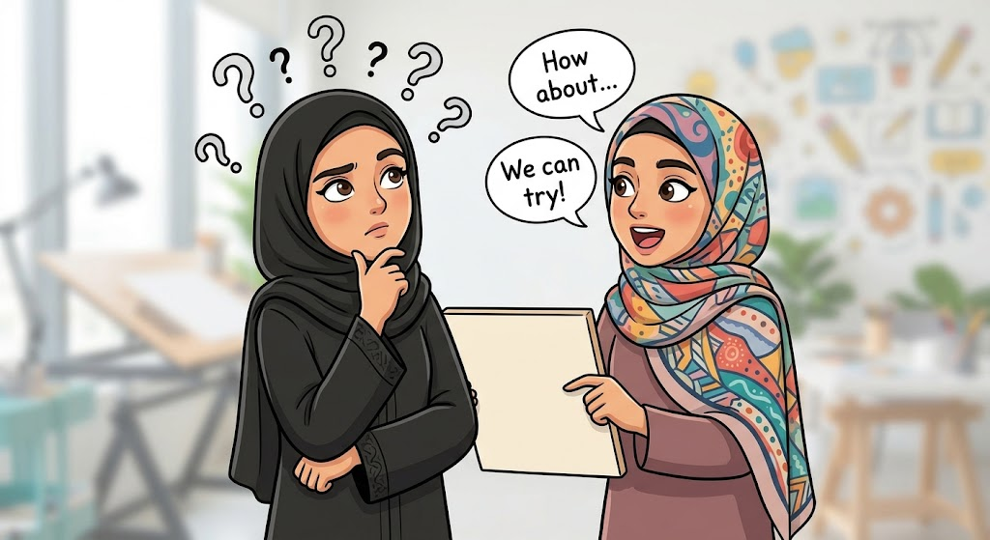
FACT
THIS IS THE REASON THAT GEN Z KIDS FIND MICROSOFT POWER POINT AS BORINGG 😑 AND CANVA PRESENTATIONS INTRESTING 😍

Slide 29
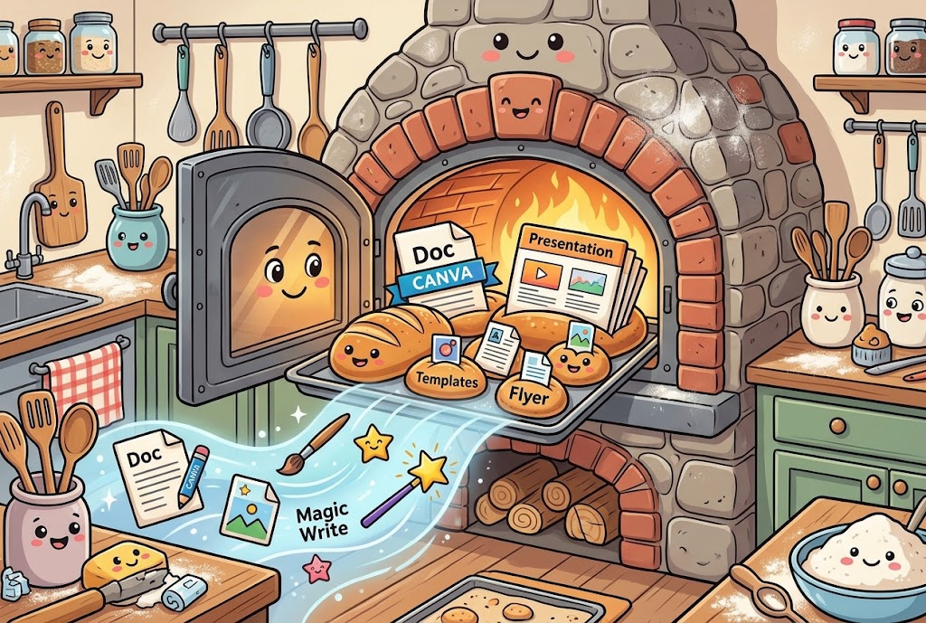
CONCLUSION
Free Access
Canva is completely free only eligible students can unlock Pro features.
No Skills Required
Templates guide you through every step, making design accessible to absolute beginners.
Time Saving
Replace boring slides with visually engaging decks and students learn more effectively with visual communication tools.

Slide 30
Questions & Answers
Open floor for any questions regarding Canva's tools or features...

Slide 31

Thank you…
for your time and participation today!

